Slide 1
MY JOURNEY
Presented by
Muhammad Noshad (2022 – SE – 37)

Slide 2
CONTENTS
Birth
Early Education
Intermediate Education
Bachelors Education

Slide 3
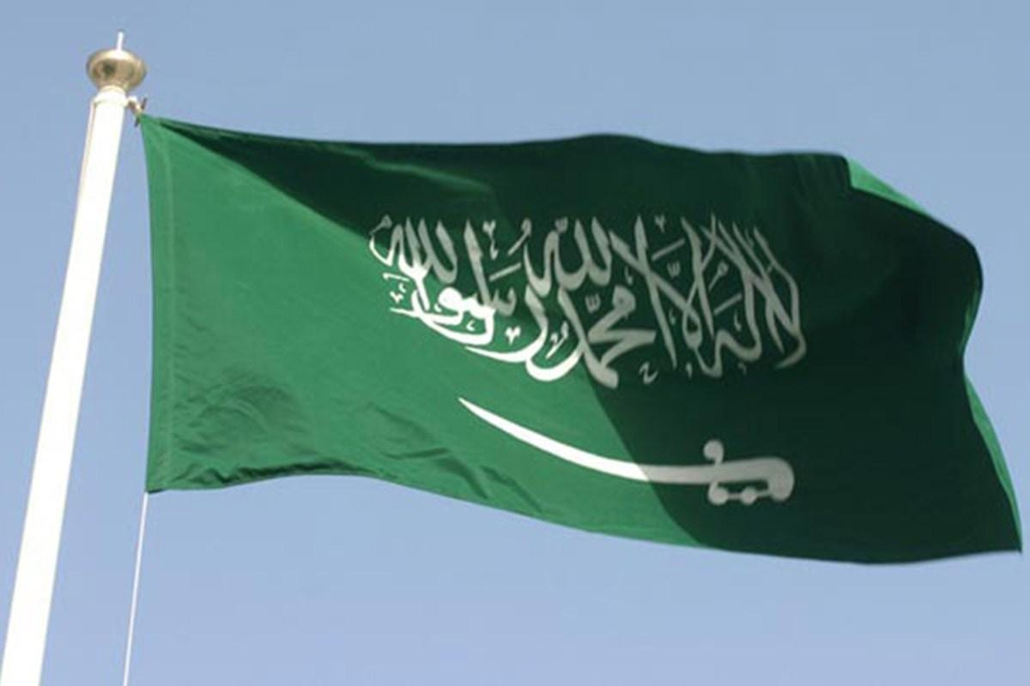
BIRTH
Born on 20th February 2004.
Born in Dammam,
Saudi Arabia.

Slide 4
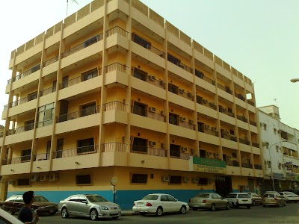
EARLY EDUCATION
Studied at Pakistan
International School,
AL-Khobar (PIS).
From Kindergarden to
Eighth class.

Slide 5
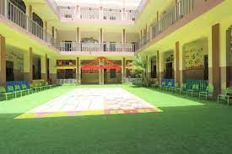
MATRIC EDUCATION
Studied in MTB School,
Khalid Campus.
From Nineth to Tenth
class.

Slide 6

INTER EDUCATION
Studied in MTB College.
From Eleventh to
Twelveth.
class.

Slide 7
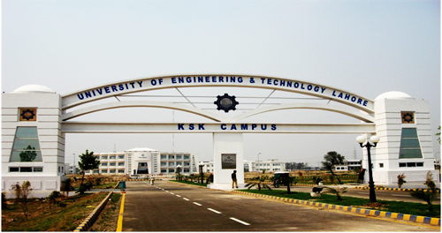
BACHELORS EDUCATION
Successfully secured
admission in UET Lahore,
New Campus.
Admitted in the discipline
of Software Engineering.

Slide 8
THANK YOU!

